Slide 1
Pipelining, Branch Prediction, Trends
10.1-10.4

Slide 2
Topics
10.1 Quantitative Analyses of Program Execution
10.2 From CISC to RISC
10.3 Pipelining the Datapath
Branch Prediction, Delay Slots
10.4 Overlapping Register Windows

Slide 3
Quantitative Analysis
CISC approach
  Belief that the semantic gap should be shortened
    The gap between machine-level instructions and high-level language statements
    Examples
      VAX Sort instruction
      IBM 360 MVC instruction (move character)
        checked if strings overlapped but this was rare
        Could be faster if assumed strings did not overlap
  Sounds reasonable, but is this assumption correct?
    Quantitatively measure programs to see

Slide 4
Quantitative Analysis
Work by Knuth/Hennessy/Patterson
  Confirmed that most complex instruction and addressing modes largely unused by compilers
    Difficult for compiler to take advantage of these modes
    Used by assembly programmers
    But most programmers used a high-level language

Slide 5
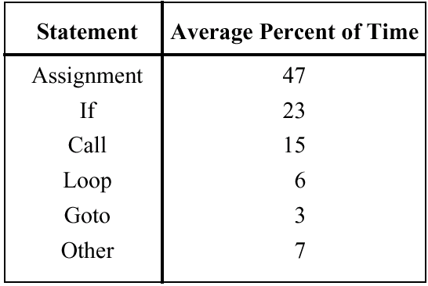
Frequency of Instructions
Frequency of occurrence of instruction types for a variety of languages/benchmark programs
Arithmetic and other “powerful” instructions only 7%

Slide 6
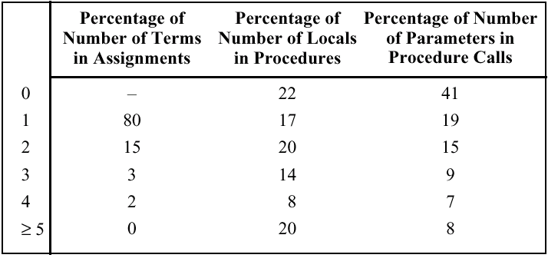
Complexity of Assignments/Procedures
80% of assignments involve one term;
80% of procedures could be handled supported 4 locals

Slide 7
Quantitative Analysis Results
Bulk of computer programs are very simple at the instruction level
Little payoff in making complex instructions
RISC idea
  Make the common case go fast; by making simple instructions fast, most programs will go fast
  Load/Store architecture
    Only way to communicate with memory is via Load/Store from register file. E.g., an ADD can’t have an operand be a memory address
    Simplifies communications and pipelining (coming up)
    Means we need a lot of registers
      Tradeoff: simpler CPU means there is space to put more registers on the chip

Slide 8
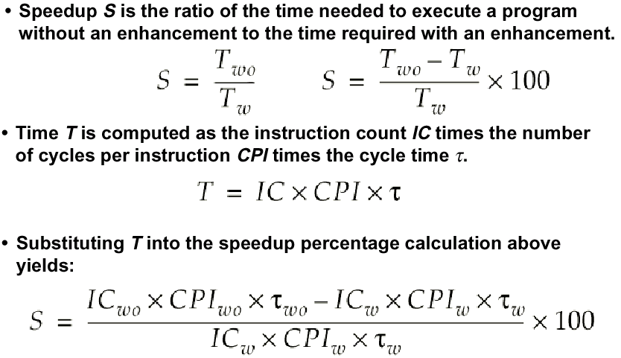
Speedup and Efficiency

Slide 9
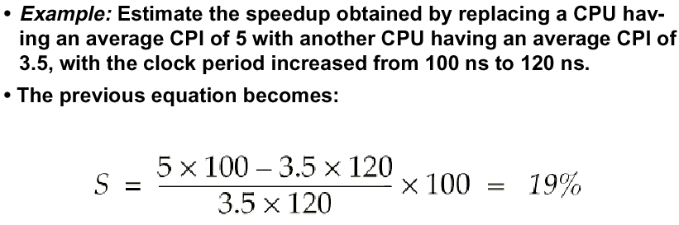
Speedup Example
Using benchmarks, we can estimate the impact of a new architecture before we actually build it!

Slide 10
Pipelining
The RISC approach lends itself well to a technique that can greatly improve processor performance called pipelining
We will see why this is more difficult with CISC instructions as we continue…

Slide 11
Instruction Prefetch
Simple version of Pipelining – treating the instruction cycle like an assembly line
Fetch accessing main memory
Execution usually does not access main memory
Can fetch next instruction during execution of current instruction
Called instruction prefetch
Notes:
36

Slide 12
Improved Performance
But not doubled:
  Fetch usually shorter than execution
    Prefetch more than one instruction?
  Any jump or branch means that prefetched instructions are not the required instructions
Add more stages to improve performance
  But more stages can also hurt performance…
Notes:
37

Slide 13

Instruction Cycle State Diagram

Slide 14
Pipelining
Consider the following decomposition for processing the instructions
  Fetch instruction – Read into a buffer
  Decode instruction – Determine opcode, operands
  Calculate operands (i.e. EAs) – Indirect, Register indirect, etc.
  Fetch operands – Fetch operands from memory
  Execute instructions - Execute
  Write result – Store result if applicable
Overlap these operations to make a 6 stage pipeline
The textbook uses a 5 stage pipeline (Fetch/Decode/Operand Fetch/Execute/Write Back)
Notes:
38

Slide 15
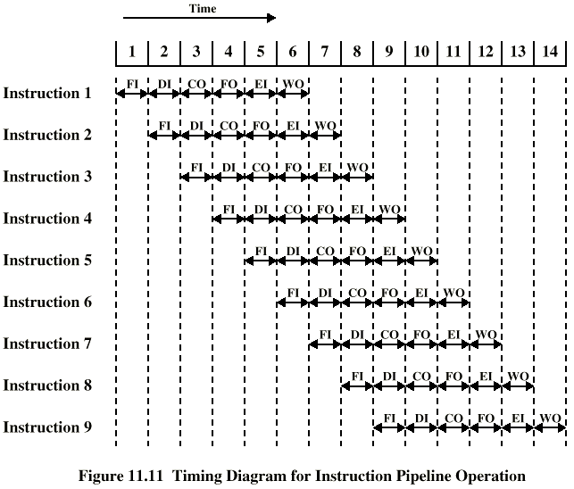
Timing of Pipeline
Notes:
39

Slide 16
Pipeline
In the previous slide, we completed 9 instructions in the time it would take to sequentially complete two instructions!
Assumptions for simplicity
  Stages are of equal duration
Things that can mess up the pipeline
  Structural Hazards – Can all stages can be executed in parallel?
    What stages might conflict? E.g. access memory
  Data Hazards – One instruction might depend on result of a previous instruction
    E.g. INC R1 ADD R2,R1
  Control Hazards - Conditional branches break the pipeline
    Stuff we fetched in advance is useless if we take the branch

Slide 17
Branch Not Taken
Branch
Not taken
Continue with
next instruction
as usual

Slide 18
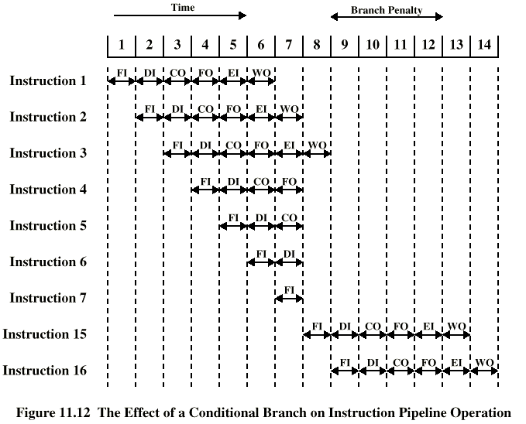
Branch in a Pipeline – Flushed Pipeline
Branch
Taken
(goto Instr 15)
Flushed
Instructions
Notes:
40

Slide 19
Dealing with Branches
Multiple Streams
Prefetch Branch Target
Loop buffer
Branch prediction
Delayed branching
Notes:
41

Slide 20
Multiple Streams
Have two pipelines
Prefetch each branch into a separate pipeline
Use appropriate pipeline
Leads to bus & register contention
Still a penalty since it takes some cycles to figure out the branch target and start fetching instructions from there
Multiple branches lead to further pipelines being needed
  Would need more than two pipelines then
More expensive circuitry
Notes:
42

Slide 21
Prefetch Branch Target
Target of branch is prefetched in addition to instructions following branch
  Prefetch here means getting these instructions and storing them in the cache
Keep target until branch is executed
Used by IBM 360/91
Notes:
43

Slide 22
Loop Buffer
Very fast memory
Maintained by fetch stage of pipeline
Remembers the last N instructions
Check buffer before fetching from memory
Very good for small loops or jumps
c.f. cache
Used by CRAY-1
Notes:
44

Slide 23
Branch Prediction (1)
Predict never taken
  Assume that jump will not happen
  Always fetch next instruction
  68020 & VAX 11/780
  VAX will not prefetch after branch if a page fault would result (O/S v CPU design)
Predict always taken
  Assume that jump will happen
  Always fetch target instruction
  Studies indicate branches are taken around 60% of the time in most programs
Notes:
45

Slide 24
Branch Prediction (2)
Predict by Opcode
  Some types of branch instructions are more likely to result in a jump than others (e.g. LOOP vs. JUMP)
  Can get up to 75% success
Taken/Not taken switch – 1 bit branch predictor
  Based on previous history
    If a branch was taken last time, predict it will be taken again
    If a branch was not taken last time, predict it will not be taken again
  Good for loops
  Could use a single bit to indicate history of the previous result
  Need to somehow store this bit with each branch instruction
  Could use more bits to remember a more elaborate history
Notes:
46

Slide 25
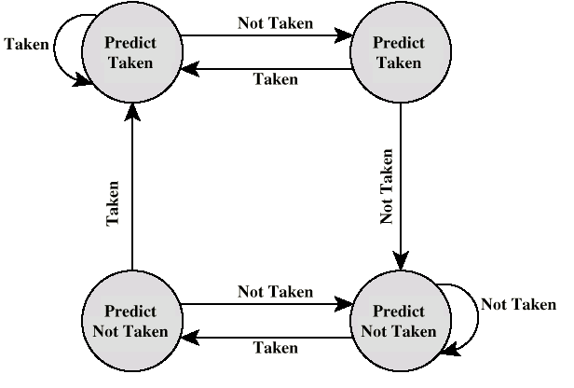
Branch Prediction State Diagram – 2 bit history
Only wrong once for branches that execute an unusual direction once (e.g. loop)
00
10
Start State
01
11

Slide 26
Branch Prediction
State not stored in memory, but in a special high-speed history table
Branch
Instruction Target
Address Address State
FF0103 FF1104 11
…

Slide 27
Dealing with Branches – RISC Approach
Delayed Branch – used with RISC machines
  Requires some clever rearrangement of instructions
  Burden on programmers but can increase performance
  Most RISC machines: Doesn’t flush the pipeline in case of a branch
  Called the Delayed Branch
    This means if we take a branch, we’ll still continue to execute whatever is currently in the pipeline, at a minimum the next instruction
    Benefit: Simplifies the hardware quite a bit
    But we need to make sure it is safe to execute the remaining instructions in the pipeline
    Simple solution to get same behavior as a flushed pipeline: Insert NOP – No Operation – instructions after a branch
      Called the Delay Slot
Notes:
47

Slide 28
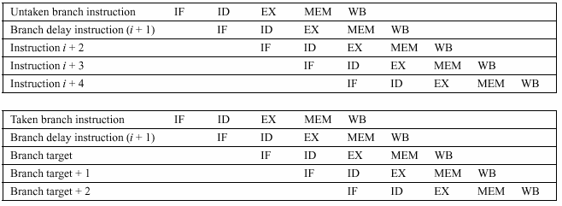
RISC Pipeline with Delay Slot
Using a Five Stage pipeline:
IF = Fetch, ID = Decode, EX = Execute
MEM = Memory access, WB = Write back register values
In this example: CPU knows if branches are to be taken after the ID
stage (implications if not known until after the EX stage?)
Notes:
40

Slide 29
Normal vs. Delayed Branch
Address Normal Delayed
100 LOAD X,A LOAD X,A
101 ADD 1,A ADD 1,A
102 JUMP 105 JUMP 106
103 ADD A,B NOOP
104 SUB C,B ADD A,B
105 STORE A,Z SUB C,B
106 STORE A,Z
One delay slot - Next instruction is always in the pipeline.
“Normal” path contains an implicit “NOP” instruction as the pipeline gets flushed. Delayed branch requires explicit NOP instruction placed in the code!

Slide 30
Optimized Delayed Branch
But we can optimize this code by rearrangement! Notice we always Add 1 to A so we can use this instruction to fill the delay slot
Address Normal Delayed Optimized
100 LOAD X,A LOAD X,A LOAD X,A
101 ADD 1,A ADD 1,A JUMP 105
102 JUMP 105 JUMP 106 ADD 1,A
103 ADD A,B NOOP ADD A,B
104 SUB C,B ADD A,B SUB C,B
105 STORE A,Z SUB C,B STORE A,Z
106 STORE A,Z

Slide 31
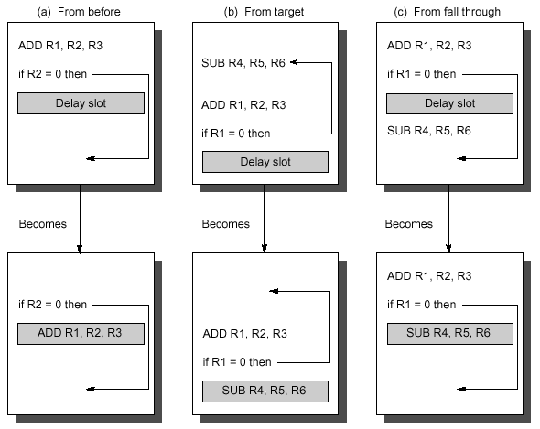
Example: Delay Slot Scheduling
B) and C) execute code that may or may not be used, but better than a NOP
Form of branch prediction – compiler predicts based on context

Slide 32
Delay Slot Effectiveness
On benchmarks
  Delay slot allowed branch hazards to be hidden 70% of the time
  About 20% of delay slots filled with NOPs
  Delay slots we can’t easily fill: when target is another branch
Philosophically, delay slots good?
  No longer hides the pipeline implementation from the programmers (although it will if through a compiler)
  Does allow for compiler optimizations, other schemes don’t
  Not very effective with modern machines that have deep pipelines, too difficult to fill multiple delay slots

Slide 33
Other Pipelining Overhead
Each stage of the pipeline has overhead in moving data from buffer to buffer for one stage to another. This can lengthen the total time it takes to execute a single instruction!
The amount of control logic required to handle memory and register dependencies and to optimize the use of the pipeline increases enormously with the number of stages. This can lead to a case where the logic between stages is more complex than the actual stages being controlled.
Need balance, careful design to optimize pipelining

Slide 34
Pipelining on the 486/Pentium
486 has a 5-stage pipeline
  Fetch
    Instructions can have variable length and can make this stage out of sync with other stages. This stage actually fetches about 5 instructions with a 16 byte load
  Decode1
    Decode opcode, addressing modes – can be determined from the first 3 bytes
  Decode2
    Expand opcode into control signals and more complex addressing modes
  Execute
  Write Back
    Store value back to memory or to register file

Slide 35
486 Pipelining Examples
Fetch
D1
D2
Ex
WB
MOV R1, M
Fetch
D1
D2
Ex
WB
MOV R1, R2
Fetch
D1
D2
Ex
WB
MOV M, R1
Fetch
D1
D2
Ex
WB
MOV R2, M
Fetch
D1
D2
Ex
MOV R1, (R2)
Need R2 written back to use as addr for second instruction in stage D2
Normally this data is not available until after the WB stage, but bypass circuitry allows us to send the proper data directly to EX of the next stage (this is called forwarding)

Slide 36
486 Pipelining Examples
Fetch
D1
D2
Ex
WB
CMP R1,Imm
Fetch
D1
D2
Ex
JCC Target
Fetch
D1
…
Target
Target address known after D2 phase
Runs a speculative Fetch on the target during EX
hoping we will execute it (predict taken)
Also fetches next consecutive instruction if branch not taken

Slide 37
Pentium II/IV Pipelining
Pentium II
  12 pipeline stages
  Dynamic execution incorporates the concepts of out of order and speculative execution
  Two-level, adaptive-training, branch prediction mechanism
Pentium IV
  20 stage pipeline
  Combines different branch prediction mechanisms to keep the pipeline full

Slide 38
Register Windows
This technique was motivated by quantitative analysis of how procedures pass parameters back and forth
Normal parameter passing: Uses the stack
  But this is slow
  Would be faster to use registers
  Benchmarks indicate that
    Most procedures only pass a few parameters
    A nesting depth of more than 5 is rare

Slide 39
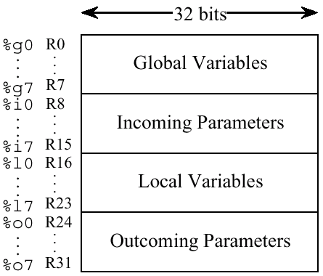
User View of Registers
Used on SPARC

Slide 40
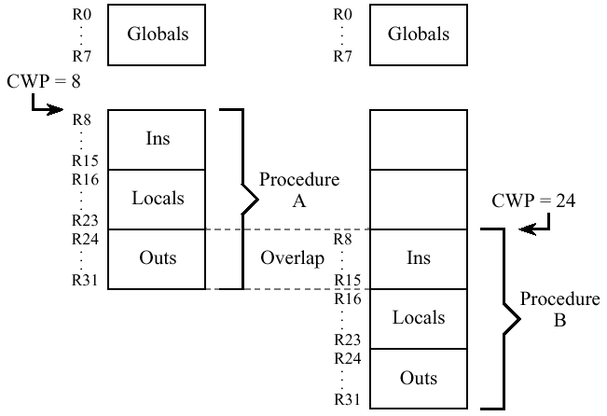
Overlap Register Windows
CWP = Current Window Pointer

Slide 41
Register Windows
Parameters are “passed” by simply updating the window pointer
  All parameter access in registers, very fast
  In the rare event we exceed the number of registers available, can use main memory for overflow

